Slide 1

Idea Evaluation
TBD
Presenter: Yuansong Xu
Group member: Yijie Fan, Jiahe Dong, Yaping Liu

Slide 2
Introduction
1

Slide 3
Introduction
General Background
The complete diagnosis process consists of three stages: before diagnosis, during diagnosis, and after diagnosis
before diagnosis
during diagnosis
after diagnosis
Chart review the patient’s electronic health record (EHR)
reviewing “previously recorded data to answer clinical queries”
ChartWalk: Navigating large collections of text notes in electronic health records for clinical chart review

Slide 4
Introduction
General Background
The complete diagnosis process consists of three stages: before diagnosis, during diagnosis, and after diagnosis
before diagnosis
during diagnosis
after diagnosis
Specific ENT Examination
Imaging Tests: X-rays, CT scans, or MRIs
Diagnosis Text
Notes:
以耳鼻喉科为例，可能用内镜检测鼻腔，耳朵，喉咙等，获得内镜图片。可能进行听力测试等获得量化指标，可能进行影像学检查比如ct，mri等

Slide 5
Introduction
General Background
The complete diagnosis process consists of three stages: before diagnosis, during diagnosis, and after diagnosis
before diagnosis
during diagnosis
after diagnosis
Retrospective case study
Collaborative discussion
For practical education in the medical domain, inexperienced doctors conduct retrospective analysis and collaborative discussion on diagnosis cases to improve their skills.
Notes:
During和after diagnosis之间界限比较模糊

Slide 6
Introduction
General Motivation
before diagnosis
during diagnosis
after diagnosis
Challenges in understanding image data comparing with the text and indicator data.
Inexperienced doctors has difficulties conducting comprehensive case study with multimodal data, which may lead to bias and mistakes (information presentation).
Existing work modeling data from different modals independently, lack inner connection and alignment. (effective communication)
Notes:
2. Backend，需要进行多模态alignment展示, 3. 如何展示，如果label很多如何呈现，还是认知负担和清晰度的问题
Existing works: 1. 现有工作默认医生可以很好的理解这些图片等信息，但存在gap 2. 多模态的工作没有很好的进alignment

Slide 7
Introduction
The specific problem you want to address
How to facilitate retrospective analysis and collaborative discussion on diagnosis case study for inexperienced doctors.?
New problem
Multimodal data visualization has been explored, but not from the alignment perspective.
The problem can be mitigated through multimodal alignment method with visual analytic analysis.

Slide 8
Introduction
Challenges
Backend: multimodal alignment, prediction, explanation
Design of interface: labeling text and indicator data to the images, balance of clarity and cognitive burden
Key contributions
Insights for inexperienced doctors during the diagnosis case study (observation study)
Multimodal data alignment, visualization, exploration of heterogeneous data
Evaluation, case study and user study

Slide 9
Related Work
2

Slide 10
Related Work
Data driven and computer based diagnosis medical case study
Big Data, EHR, deep learning and machine learning
Inexperienced doctor
ChartWalk: Navigating large collections of text notes in electronic health records for clinical chart review
Multimodal data analysis
Existing work modeling separately
Multimodal fusion for model prediction
Deep Multi-modal Fusion of Image and Non-image Data in Disease Diagnosis and Prognosis: A Review
Mutimodal, heterogeneous data visualization
RL-LABEL: A Deep Reinforcement Learning Approach Intended for AR Label Placement in Dynamic Scenarios

Slide 11
Method
3

Slide 12
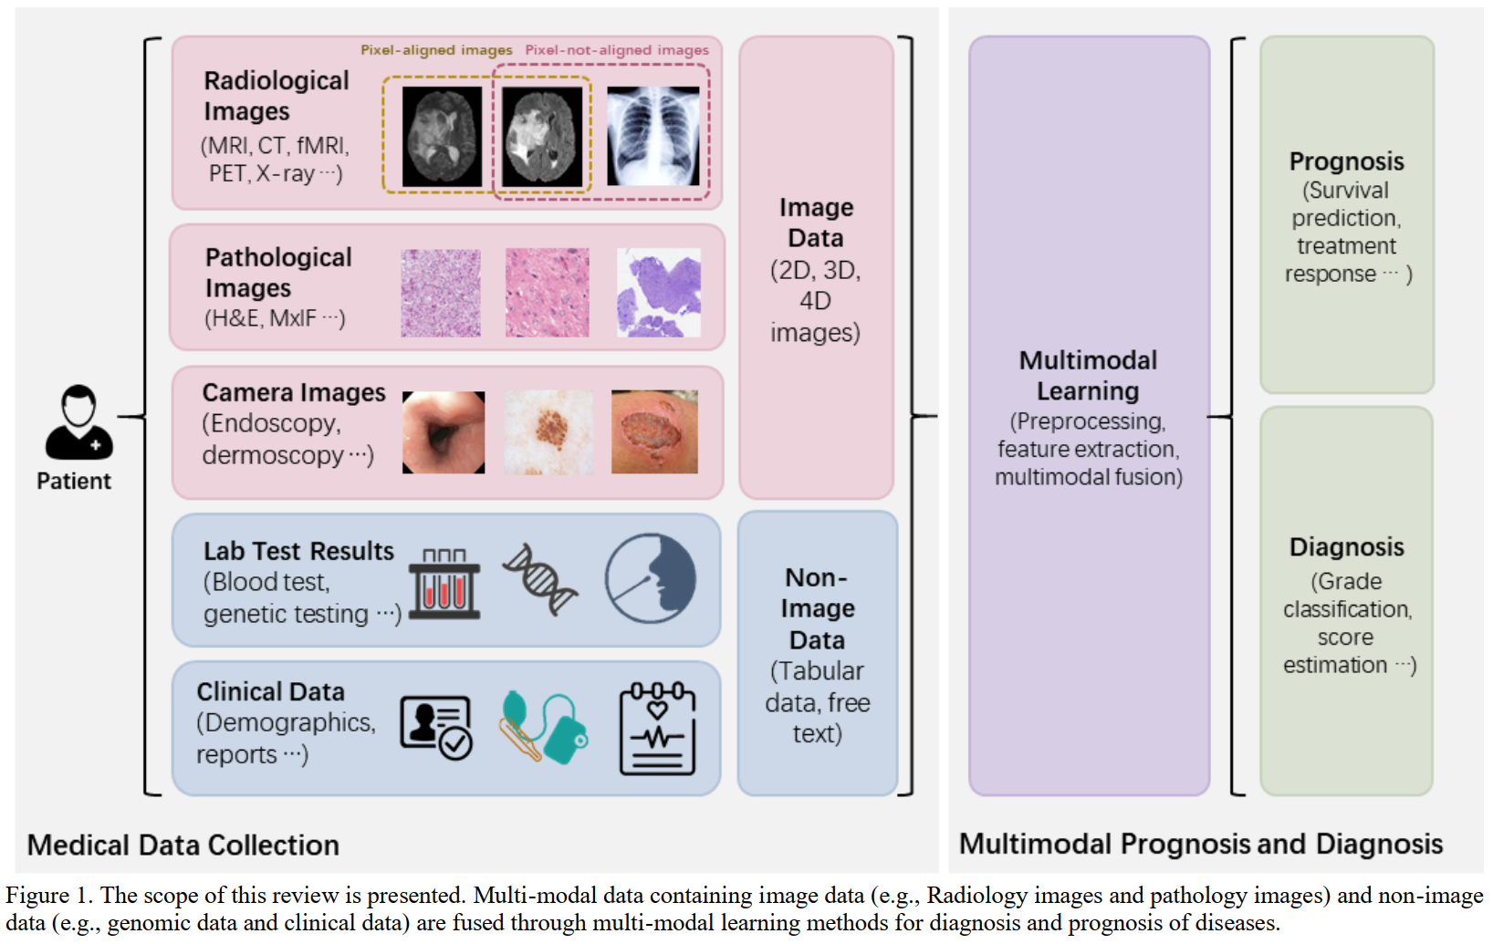
Method
Backend： alignment, prediction, explanation

Slide 13
Method
Frontend:
The heterogeneous data: 2d, 3d, time-series, text, …
zoom in: zoom in for more details
hover: hovering for specific area
scroll, etc

Slide 14
Evaluation
User study
Controlled study:
Base line: multimodal data, presented without alignment
Our system
Task: Retrospection & Collaborative discussion
Participants: medical student, inexperienced doctors, experienced doctors
Measurement:
Likert scales
Ratings for case related questions after collaborative discussion

Slide 15
Evaluation
Case study
Case1: Self retrospection
Case2: Collaborative discussion

